Slide 1
Trees Plus-Balanced Binary Trees

Slide 2
Trees Plus
We introduced the binary tree, a useful structure for implementing ADTs
However, its efficiency is only guaranteed if the tree is balanced (near log₂N height)
This chapter explores binary trees that self-balance when nodes are added or removed

Slide 3
Balanced Binary Trees
Balance Factor: The difference in height between the two subtrees of a binary tree
A tree is balanced if its balance factor is 0 or 1
By rebalancing when the balance factor grows too large, tree operations will remain efficient
This should be checked after insertion and deletion operations, since these can change the height of the tree

Slide 4
AVL Trees
AVL Tree: A binary search tree that balances itself when the balance factor is greater than 1
It uses tree rotations to rebalance the tree if necessary after insertion and deletion
AVL Trees are O(log₂N) in the average and worst cases

Slide 5
Tree Rotations
Rotation: Switching the positions of a child node and its parent
The direction to rotate depends on the structure of the tree and the location of the inserted or deleted node
Every imbalance can be solved with only one or two rotations

Slide 6
The Four Rotation Cases
The rotation cases are based on the location of the inserted node
They’re the same for deleting a node; for simplicity, this discussion focuses on inserting nodes
The following examples discuss the rotations in terms of an unbalanced node T with two children, L (on the left) and R (on the right)
Remember, rotations are only used if the tree becomes unbalanced

Slide 7
The Four Rotation Cases (cont.)
Right rotation: Used when inserting into the left subtree of T’s left child
Left rotation: Used when inserting into the right subtree of T’s right child
Right-Left rotation: Used when inserting into the left subtree of T’s right child
Left-Right rotation: Used when inserting into the right subtree of T’s left child

Slide 8
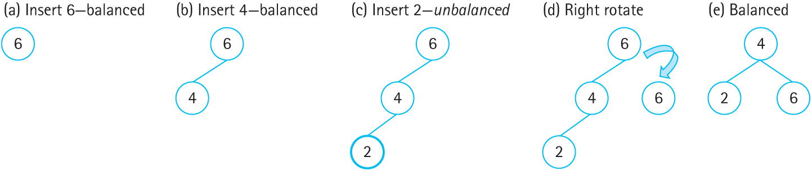
Right Rotation
Figure 10.2 Right rotation on an unbalanced tree (a) Insert 6- balanced
(b) Insert 4- balanced (c) Insert 2- unbalanced (d) Right rotate (e) balanced

Slide 9
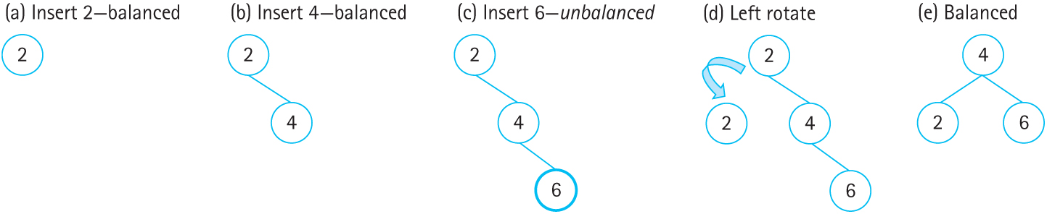
Left Rotation
Figure 10.3 Left rotation on an unbalanced tree (a) Insert 2- balanced
(b) Insert 4-balanced (c) Insert 6- unbalanced (d) Left rotate (e) Balanced

Slide 10
Single Rotations
A single left or right rotation reduces the height of the tree by 1
A right rotation is used if the height of the left subtree is greater than the right subtree
A left rotation is used if the height of the right subtree is greater than the left subtree

Slide 11
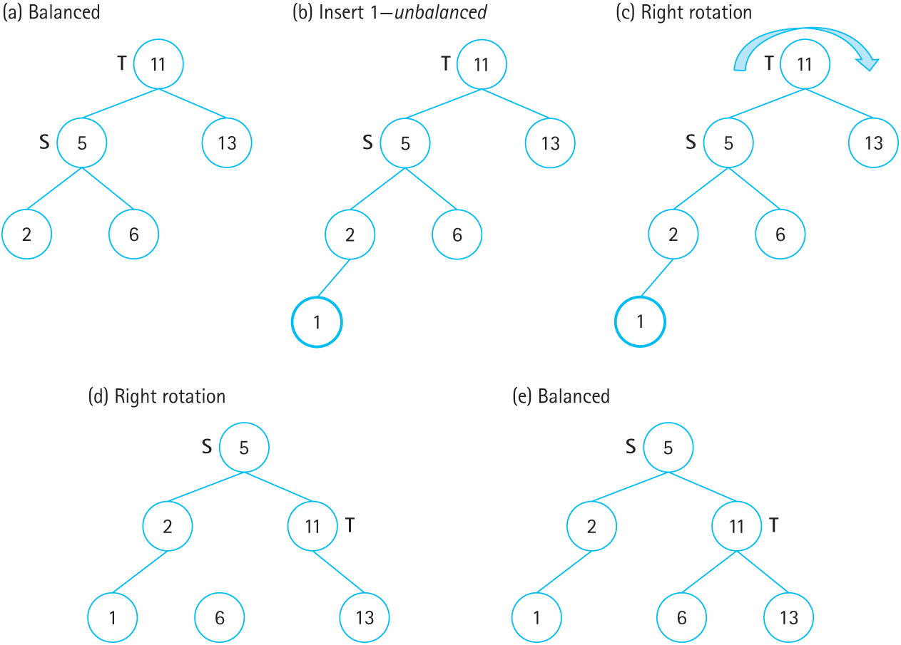
Right Rotation
Figure 10.6 Right rotation on AVL tree after insert (a) Balanced (b) Insert 1- unbalanced (c) Right rotation (d) Right rotation (e) Balanced

Slide 12
Double Rotations
Sometimes a single rotation is not enough
Instead, a double rotation is used
The first rotation in the double sets up the tree for the second rotation

Slide 13
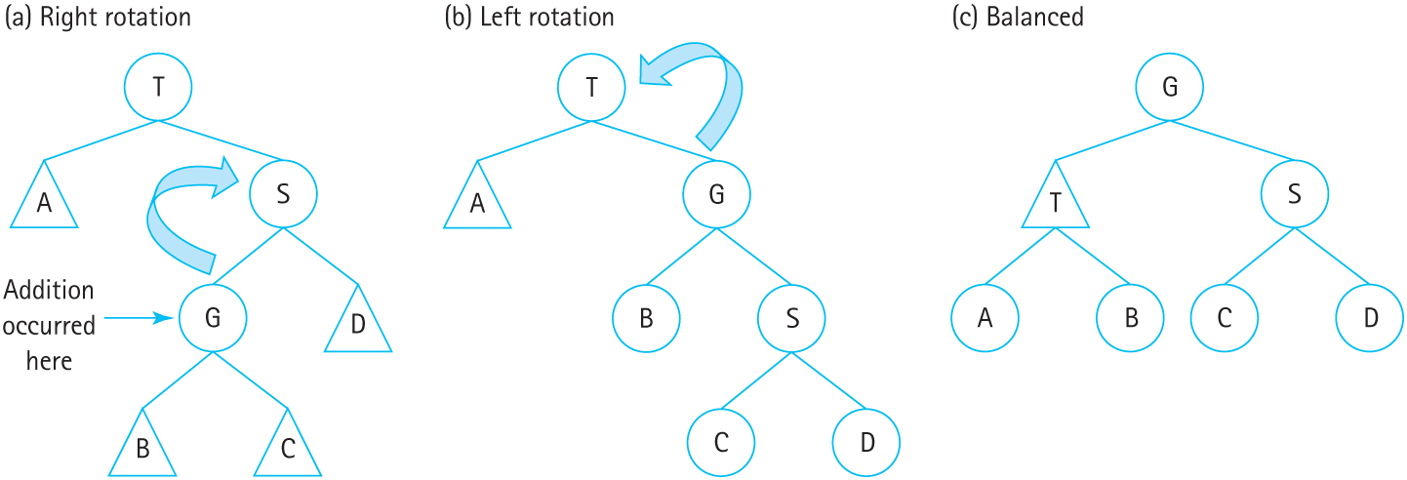
Right-Left Rotation
Figure 10.9 General right-left rotation on AVL tree (a) right-rotation (b) left-rotation
(c) balanced

Slide 14
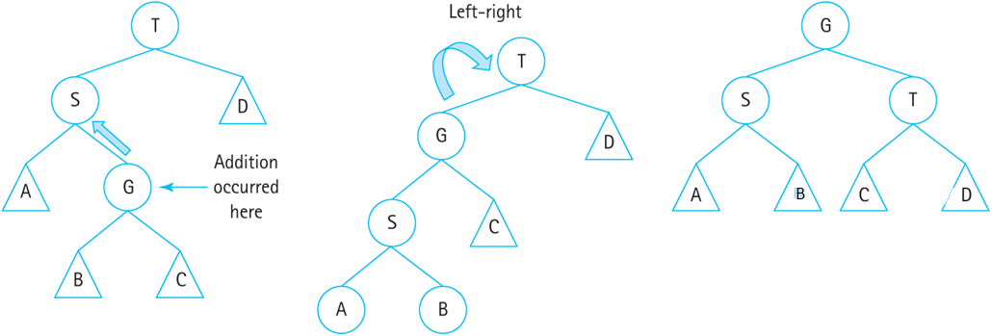
Left-Right Rotation
Figure 10.10 General right-left rotation on AVL tree (a) right-rotation (b) left-rotation
(c) balanced

Slide 15
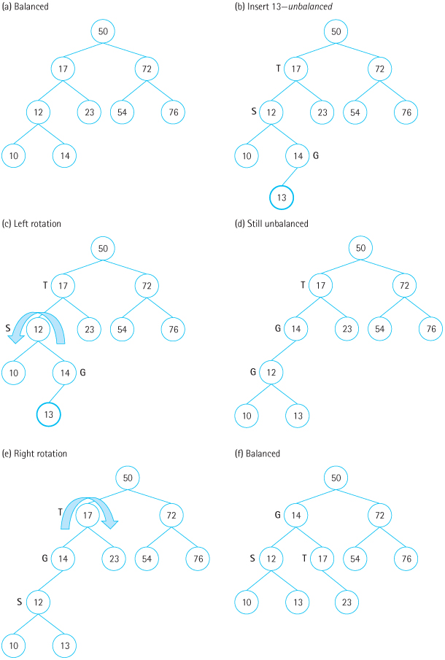
Figure 10.8 Left-right rotation on AVL tree after insert (a) Balanced (b) Insert 13- unbalanced (c) Left rotation (d) Still unbalanced (e) Right rotation (f) Balanced

Slide 16
AVL Trees: Logical Level
AVL trees and binary search trees share the same operations
AVL trees add additional conditions to PutItem and DeleteItem: The tree will be balanced before and after these operations are performed

Slide 17
AVL Trees: Application Level
Binary search trees are great for random, unchanging data; the tree can be balanced once and left alone
AVL trees are better when insertion and deletion operations are performed over the lifetime of the tree

Slide 18
AVL Trees: Implementation Level
The AVL Tree implementation has a few more helper functions:
The four rotation functions
Difference, for finding the difference in height between two subtrees
Balance, for deciding which rotation is needed
PutItem and DeleteItem call Balance after performing the insertion/deletion

Slide 19
Rotation Functions
The rotations themselves are straightforward
Each one takes the unbalanced node as a parameter and returns the updated root node
Compare the code to the rotations diagrams

Slide 20
RotateRight
TreeNode* RotateRight(TreeNode* T)
// Returns the tree node resulting from
// a right rotation.
{
TreeNode* S = T->left;
TreeNode* B = S->right;
S->right = T;
T->left = B;
return S;
}

Slide 21
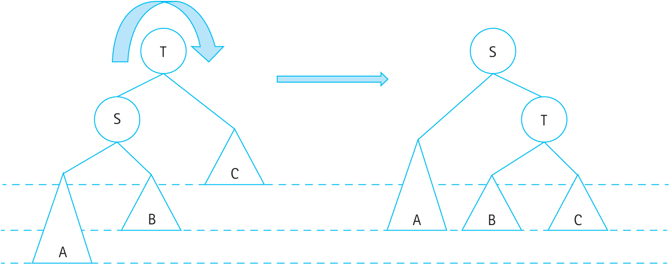
RotateRight (cont.)
Figure 10.4 Right rotation on an AVL tree to maintain balance

Slide 22
RotateRight (cont.)
Figure 10.6 Right rotation on AVL tree after insert (a) Balanced (b) Insert 1- unbalanced (c) Right rotation (d) Right rotation (e) Balanced

Slide 23
RotateLeft
TreeNode* RotateLeft(TreeNode* T)
// Returns the tree node resulting from
// a left rotation.
{
TreeNode* S = T->right;
TreeNode* B = S->left;
S->left = T;
T->right = B;
return S;
}

Slide 24
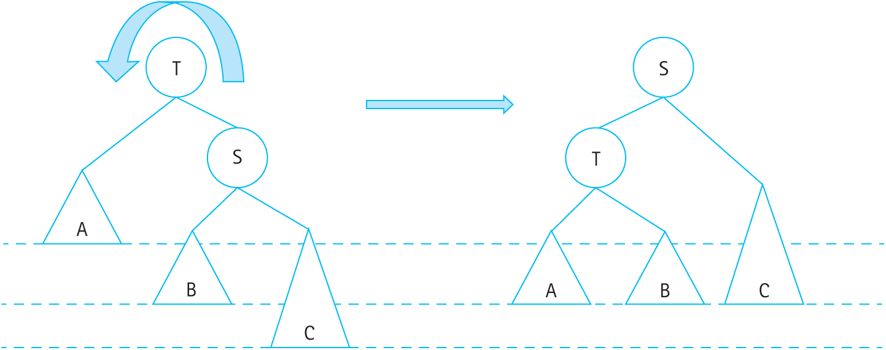
RotateLeft (cont.)
Figure 10.5 Left rotation on an AVL tree to maintain balance

Slide 25
RotateRightLeft
TreeNode* RotateRightLeft(TreeNode* T)
// Returns the tree node resulting from a
// right-left rotation.
{
TreeNode* S = T->right;
T->right = RotateRight(S);
return RotateLeft(T);
}

Slide 26
RotateRightLeft (cont.)
Figure 10.9 General right-left rotation on AVL tree (a) right-rotation (b) left-rotation (c) balanced

Slide 27
RotateLeftRight (cont.)
TreeNode* RotateLeftRight(TreeNode* T)
// Returns the tree node resulting from a
// left-right rotation.
{
TreeNode* S = T->left;
T->left = RotateLeft(S);
return RotateRight(T);
}

Slide 28
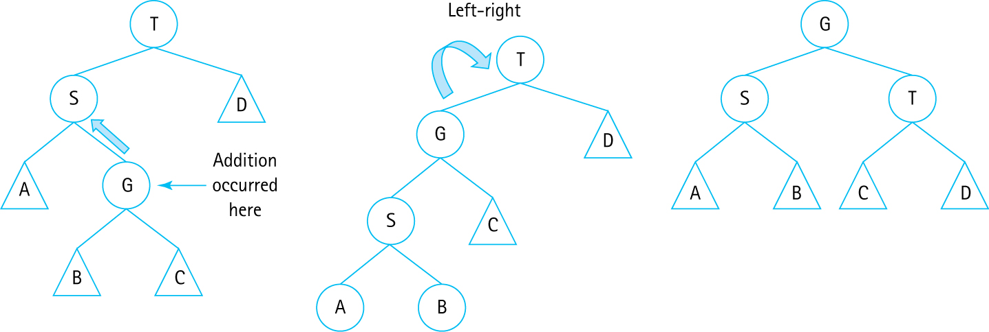
RotateLeftRight (cont.)
Figure 10.10 General left-right rotation on AVL tree

Slide 29
Difference
Difference returns the difference in height between the two subtrees of the given node
If the difference is positive, the left tree is taller
If the difference is negative, the right tree is taller
This is used by Balance to determine which rotation to use

Slide 30
Difference (cont.)
int Difference(TreeNode* T) const
// Returns the difference between the heights
// of the left and right subtrees of T.
// Assumes the given TreeNode* T is not null.
{
return Height(T->left) – Height(T->right);
}

Slide 31
Height
A recursive helper function that calculates the height of the tree rooted at the given node
The height of a tree is the height of its tallest subtree + 1
If the node is NULL, the height is 0 (base case)

Slide 32
Height (cont.)
int Height(TreeNode* T) const
// Returns the height of a tree T.
{
if (T == null)
return 0;
else {
int heightLeft = Height(T->left);
int heightRight = Height(T->right);
if (heightLeft > heightRight)
return heightLeft + 1;
else
return heightRight + 1;
}
}

Slide 33
Balance
Balance is called by Insert to check if a rotation is needed to balance the tree
If a node’s height difference (the balance factor) is greater than 1, it is unbalanced
The Difference function is used to determine which rotation is needed

Slide 34
Balance (cont.)
TreeNode* Balance(TreeNode* T)
// Checks and balances the subtree T.
{
int balanceFactor = Difference(T);
if (balanceFactor > 1) { // Left subtree is taller
if (Difference(T->left) > 1)
return RotateRight(T);
else
return RotateLeftRight(T);
}
else if (balanceFactor < -1) { // Right subtree is taller
if (Difference(T->right) < 0)
return RotateLeft(T);
else
return RotateRightLeft(T);
}
else
return T;
}

Slide 35
Insert and PutItem
These methods are almost identical to the BST versions, except for calls to Balance
Insert: After inserting into the left or right subtree, Balance is called on that subtree
PutItem: After the call to Insert, the root is balanced

